Slide 1
TEAM MEMBERS
TEAM LEADER
MEENA R
SHOBA M
MENAKA A
VINITHA M
PRIYA A
POOJA SRI M

Slide 2

A COMPREHENSIVE ANALYSIS OF FINANCIAL PERFORMANCE: INSIGHTS FROM A LEADNG BANKS

Slide 3

1.INTRODUCTION
The banking industry world-wide is being transformed.
The global forces for change include technological innovation; the deregulation of financial services at the national level and opening-up to international competition; and-equally important-changes in corporate behavior, such as growing disintermediation and increased emphasis on shareholder value.
In addition, recent banking crises in Asia and Latin America have accentuated these pressures.

Slide 4
PURPOSE OF THIS PROJECT
Insights generations using Business Intelligence.
Building Date models using Statistics.
Developing the predictive models
In this project we are trying to analysis the bank related data and able to extract some insights from the date using Business Intelligence tools.
To Extract the Insights from the data and put the data in the form of visualizations, Dashboards and Story we employed Tableau tool.

Slide 5

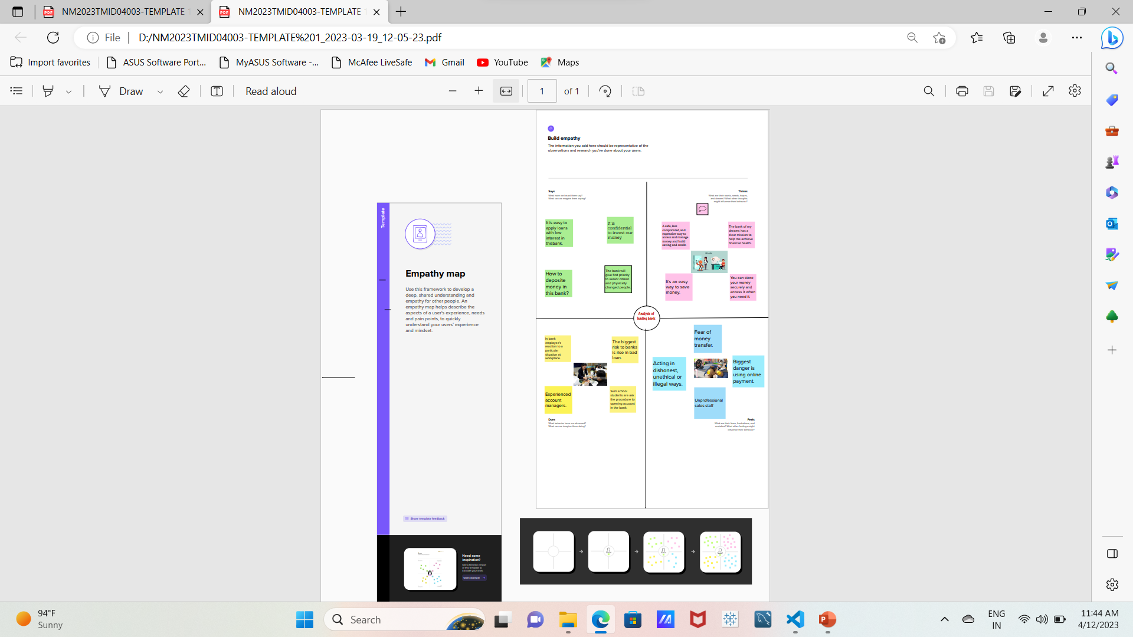
2.Problem definition and design thinking
EMPATHY MAP

Slide 6

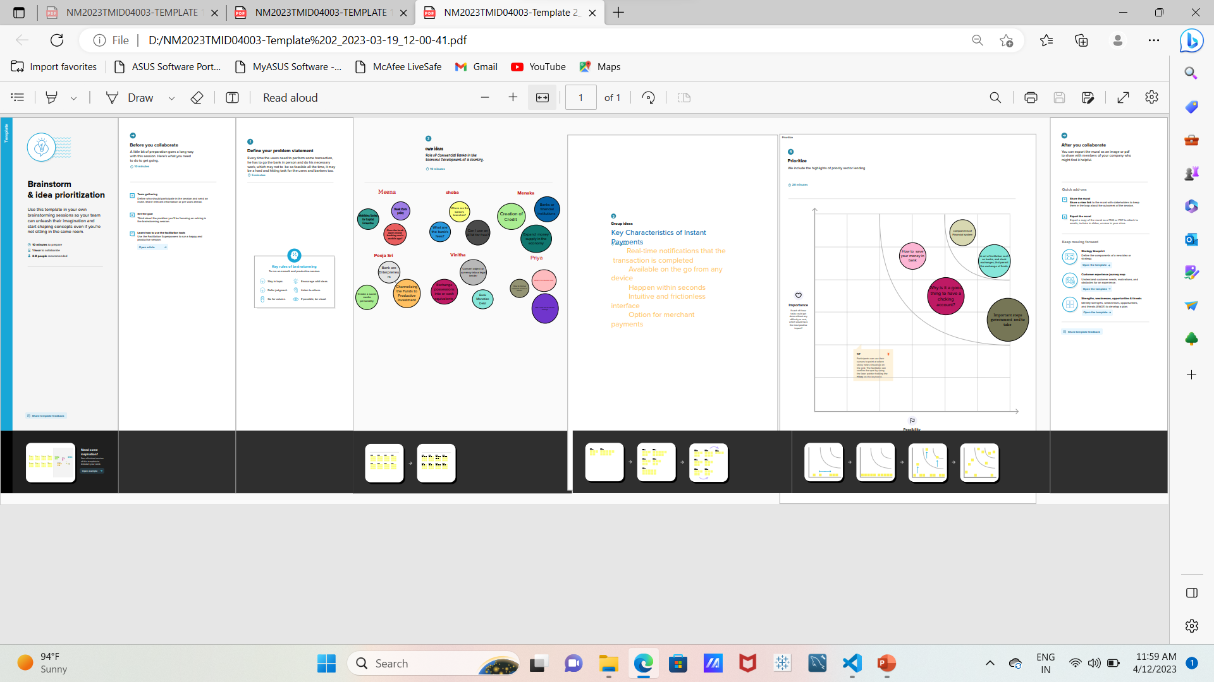
IDEATION AND BRAINSTORMING MAP

Slide 7

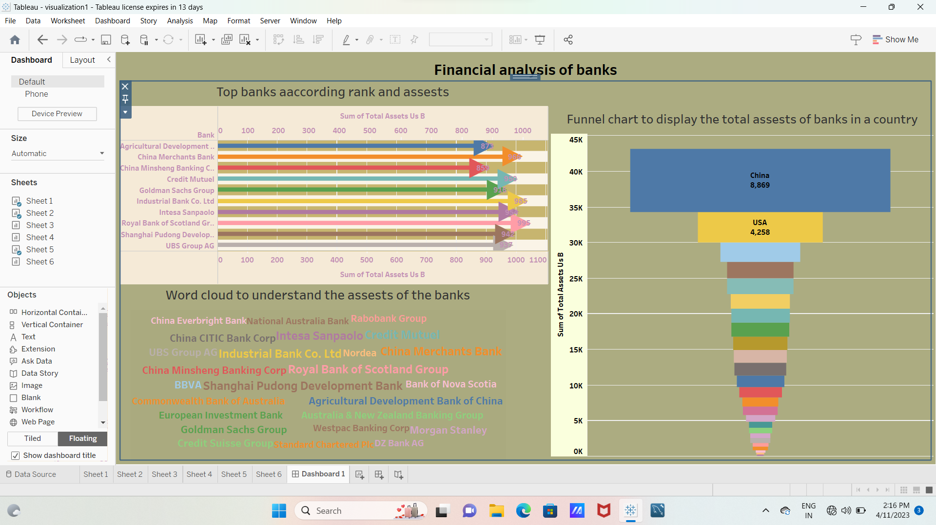
3.RESULT
DASHBOARD

Slide 8

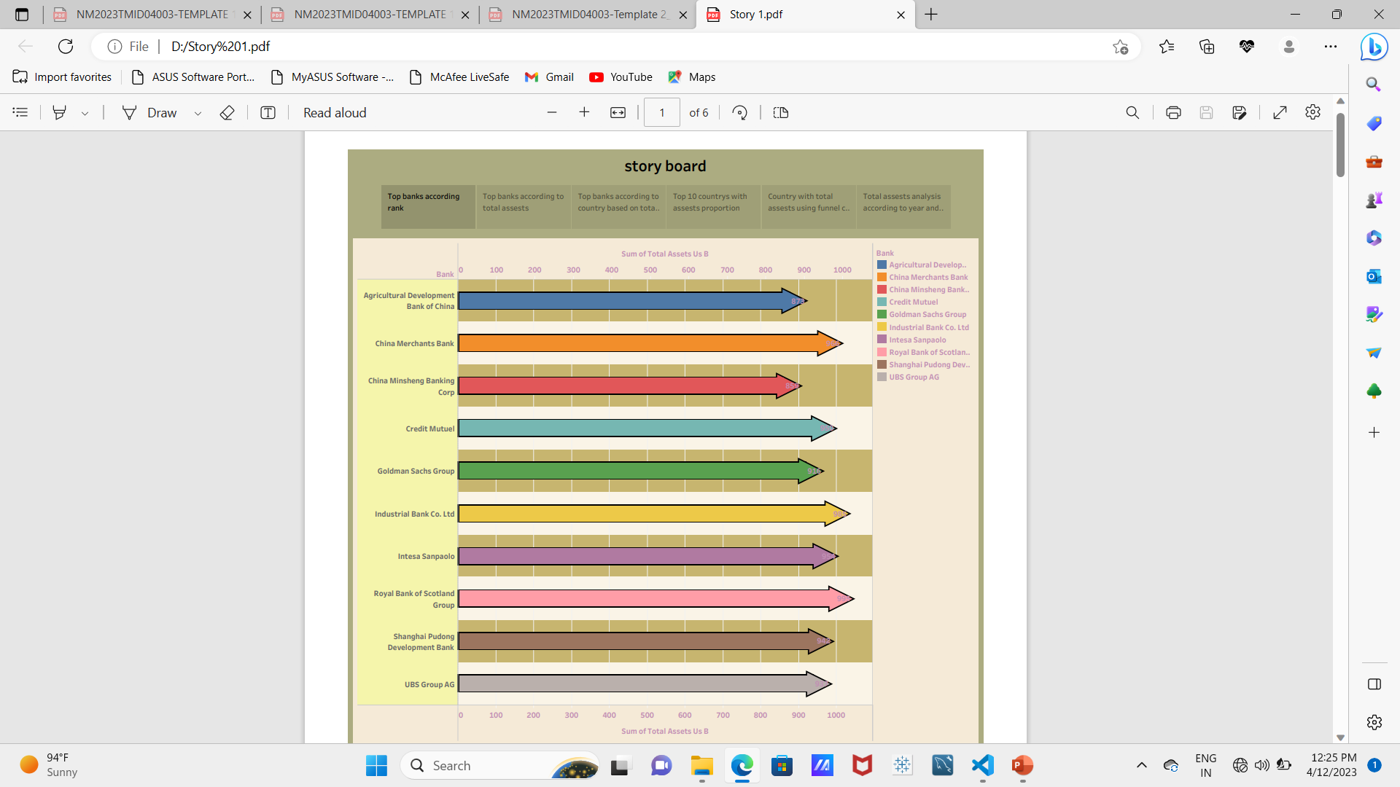
INSIGHTS FROM A LEADING BANKS: STORY

Slide 9
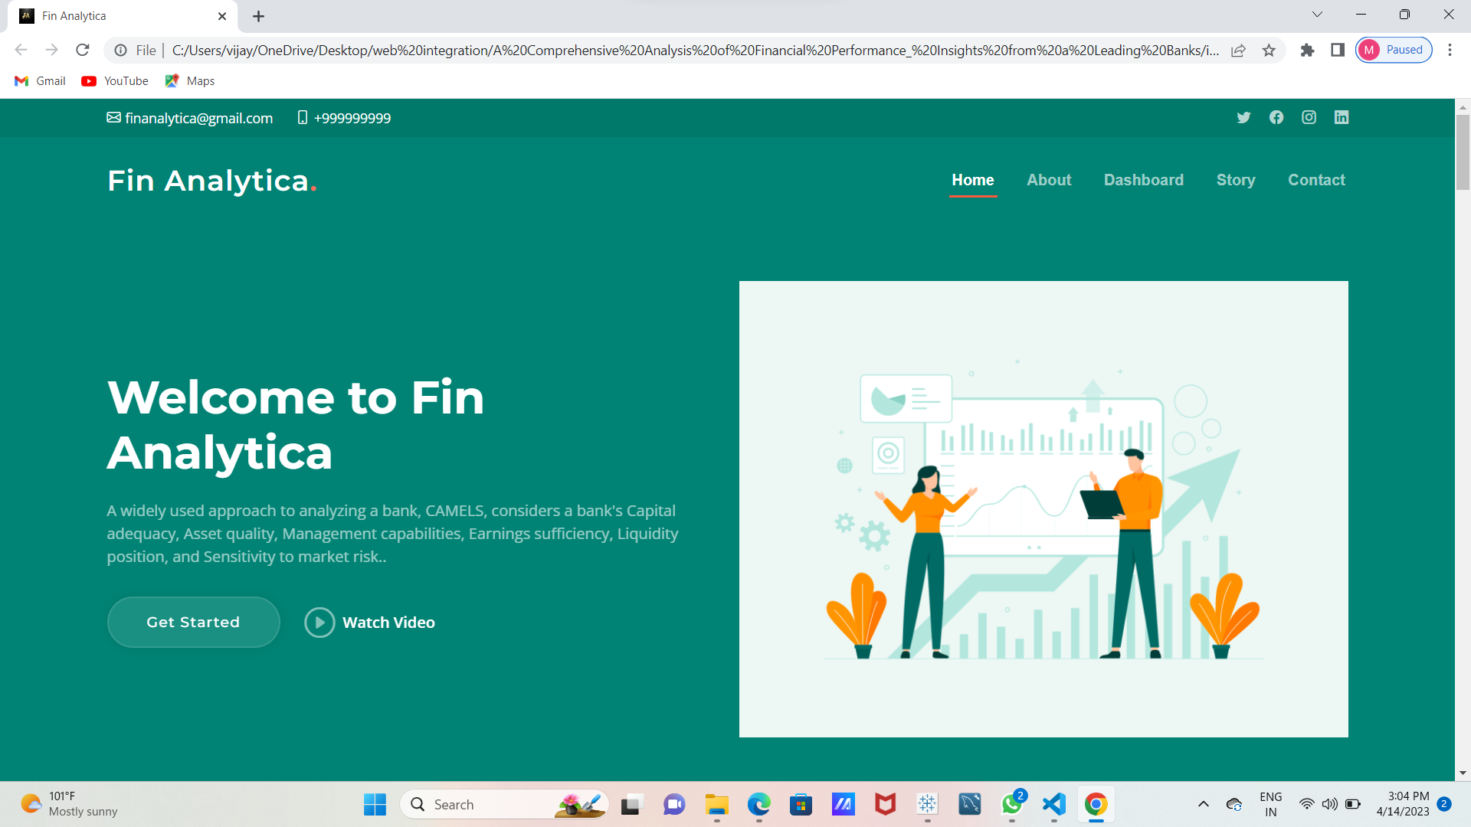
WEB INTEGRATION
.

Slide 10
4.MERITS AND DEMEITS IN LEADING BANK

Slide 11
Advantages of leading banks
Instead of walking around with wads of cash or hiding it under the floorboards, banks provide you with a protected place to store your money without worrying about theft.
The qualifications for loans are relatively standard across most banks. Modern establishments have broken this cycle by increasing accessibility to loans and offering more reasonable requirements.
Banks often act as lenders for large amounts of capital to various economic sectors like agriculture and small businesses, which, in turn, raises employment rates and spending power.
The government expect banks to support particular facets of society. Rural or underdeveloped communities and industries are two such areas. Investing and approving loans in these areas increases development and modernization while building local branches to improve access to banking services.

Slide 12
DISADVANTAGES OF LEADING BANKS
Banks can suffer if customers spend less or decide to withdraw their money out of fair that the bank will go bankrupt. This can occur in a crashing economy, as seen during the Great Depression.
Online banking is extremely convenient. With the click ok a button, you can withdrawn or transfer money, set up a new checking account or saving account or pay your monthly balance off.
Unfortunately, this also means that it’s far easier for another party to access your information.
Cybercrime and identity theft have been increasing over the years.

Slide 13
5.APPLICATION OF LEADING BANKS
Dashboard – a central predictive analytics dashboard that can be shared across call centers, back office, and agents in the bank.
The logging happens as the applications are used for conducting transactions and the average length of time each activity occurred.
The measure of time is critical here and cannot be missed.
If the customer is dissatisfied they might not reply or we need to watch for a social media outburst of poor service in the next few hours.
Outcomes-will be updated with graphics based on outcomes from algorithms, and administration teams on critical churn outcomes.

Slide 14
6.Conclusion of leading bank
Competition is faced from public, private, foreign and cooperative banks. They have adopted the strategy for affective workings are use of advance technology and changes in working procedure. No doubt performance has been improved that manpower is not maintained and utilized properly.
For improvement in human resources, special focus should be given on selection, training, motivate career opportunities or employees etc.
Mainly the customers are convinced by goodwill and employees of banks to open a new account.
It the only manpower that makes the difference. The impact of employees is very good on performance, profitability, progress and goodwill of banks.
Finally, it can be improved further because there is a scope for further improvement. With higher productivity and performance of employees the future of banks is going to be bright definitely.

Slide 15
7.Future scope
Financial institutions needs to embrace advanced technologies such as analytics and artificial intelligence to improve threat visibility and detect fraud effectively.
Bank need to embrace change and harness the power of digital forces to innovate in smaller, bolder cycles.
Banks will need to decide how they want to utilize platforms, and the data behind them, in order to grow
Increasing sophistication of customer portals.

Slide 16
THANK YOU

